Slide 1
Expression and Functions of BTLA-HVEM couple in lung cancer
Congrès SFPO 2019 – Prix E. Bzoura
Clémence Demerlé
2nd Year Ph.D
Director : Pr D. Olive
Immunity and Cancer Team, CRCM
Resident Pharmacist in medical biology
Immunology Laboratory (Pr JL. Mège, APHM)

Slide 2
Major players in tumoral environment
Immune Cells :
Lymphoïd Cells
Myeloïd Cells
Tumoral stroma
Multiple interactions :
Soluble mediators
Cell to cell contacts
Yan Cui and Gang Guo Int. J. Mol. Sci. 2016

Slide 3
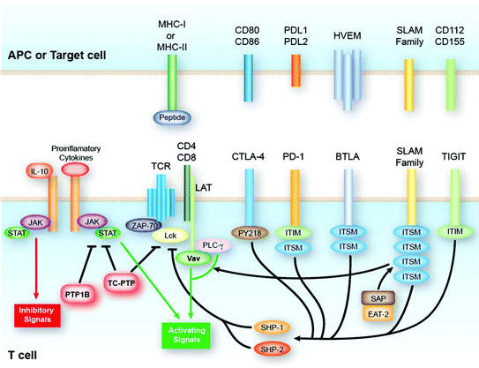
HVEM – BTLA Axis in lung cancer : a promising candidate as immunotherapy target
BTLA is a co-inhibitory receptor expressed by T and B cells
BTLA shares similarities with PD-1 and CTLA-4 but seems to be associated with a terminal exhausted T state.
The immune checkpoint, HVEM may contribute to immune escape in non small cell lung cancer (NSCLC) lacking PD-L1 expression
Penafuerte C et al 2017
D. Thommen et al, Cancer Immunology Research, 2015
Shengxiang R et al, Lung Cancer, 2018

Slide 4
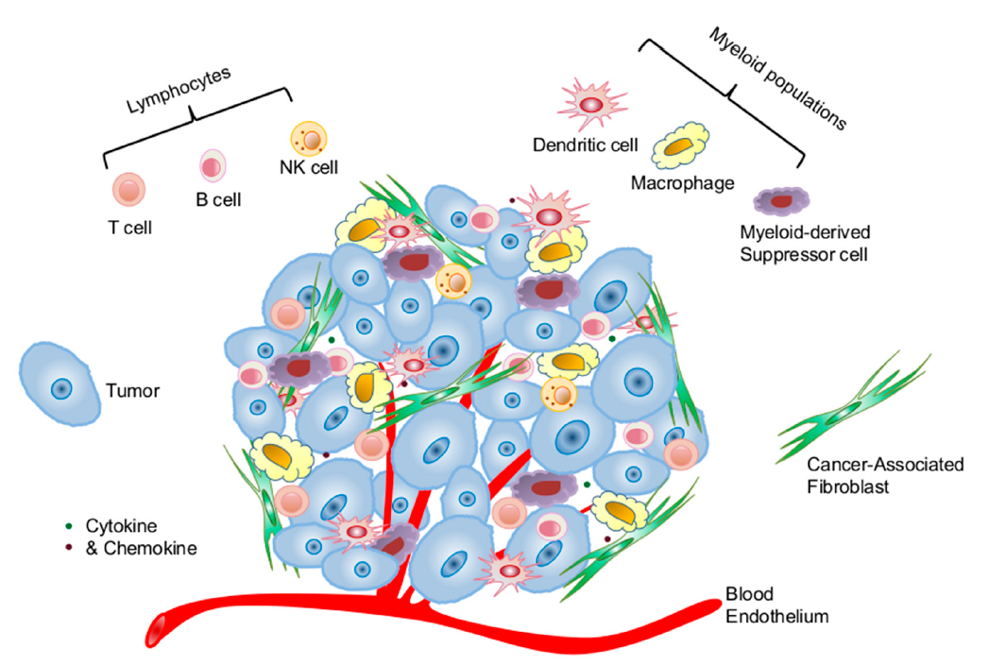
Experimental Project
Part I : In vitro functional assays to test anti-BTLA or anti-HVEM antibodies.
Part II : Characterize cellular environment in lung cancer by mass cytometry

Slide 5
Part I : In vitro functional Assay
Mimicking T cell activation in vitro on healthy human PBMC
First signal = PBMC pre-activation
CD3 stimulation (OKT3)
Second signal = Co-signalisation
Block the co-inhibitory signal with anti-BTLA antibodies
Penafuerte C et al 2017

Slide 6
Part I : In vitro functional Assay
Mimicking T cell activation in vitro on healthy human PBMC
Workflow
First signal = PBMC pre-activation
CD3 stimulation (OKT3)
Second signal = Co-signalisation
Block the co-inhibitory signal with anti-BTLA antibodies
Process : 3-days incubation (37°C, 5% CO₂)
Day 0 : cells labeling (CTV) to trace cells proliferation using dye dilution.
Day 3 : Multi-parametric Flow Cytometry Assay
-Proliferation
-Expression of activation and maturation markers
-Cytokines synthesis
With different culture conditions :
Tumor dissociation supernatant
Co-culture with tumoral cell lines expressing HVEM and/or PDL1
Penafuerte C et al 2017

Slide 7
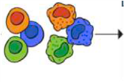
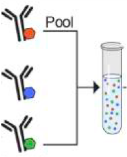
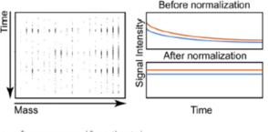
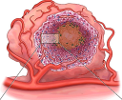
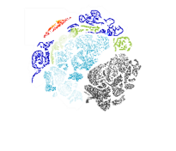
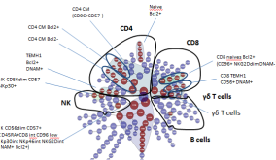
Part II : Characterize cellular environment in lung cancer by mass cytometry
1/ Sample Processing
2/ Mass Cytometry Experiment
Mass Cytometry (CyTOF®)
Adjacent
tissue
Extracellular
staining
Barcode
/pool
Intracellular
staining
Run on
Helios
Normalization
Tissue infiltrating Lymphoïd and myeloïd cells, Fibroblasts
Tumor
Tumor infiltrating Lymphoïd and myeloïd cells, Cancer Associated Fibroblasts
Peripheral
blood
3/ Multi-dimensional dataset analysis
PBMC
Tumor Dissociation
One Panel : 2³⁵ theorical populations to explore (2D)
Cell clustering
and identification
Algorithms
(Citrus, Hclust)
tSNE2
tSNE1

Slide 8
Part II : Characterize cellular environment in lung cancer by mass cytometry
1/ Sample Processing
2/ Mass Cytometry Experiment
Mass Cytometry (CyTOF®)
Adjacent
tissue
Extracellular
staining
Barcode
/pool
Intracellular
staining
Run on
Helios
Normalization
Tissue infiltrating Lymphoïd and myeloïd cells, Fibroblasts
Tumor
Tumor infiltrating Lymphoïd and myeloïd cells, Cancer Associated Fibroblasts
Peripheral
blood
PBMC
Tumor Dissociation
JUNE 2019 : Proof of Concept
10 samples for the « proof of concept »
and workflow + mass cytometry optimization
Workflow Optimization :
Dissociation process : enzymatic or not ?
Dissociation yield / size of the biopsies
Cell preservation
Starting in Novembre 2019 (expected) :
40- 50 samples to process with the validated workflow

Slide 9
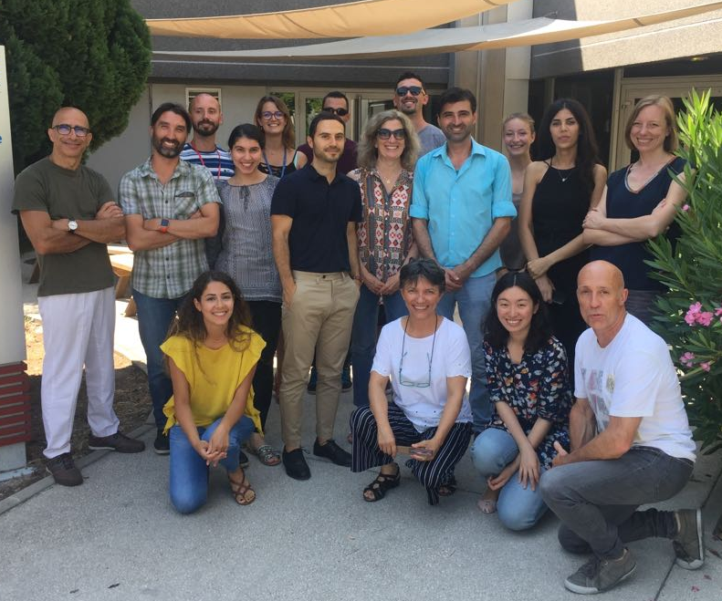
Aknowledgments
Equipe Immunité et Cancer Pr. D Olive, Dr. J Nunes
Plateforme d’immunomonitoring Pr. D Olive
Anne-Sophie Chrétien, Cyril Fauriat, Raynier Devillier,
Françoise Rey, Geoffrey Guittard, Esma Karkeni,
Clara Degos, Aude Le Roy
Bernadette Barbarat, Philippe Livrati,
Florence Orlanducci, Sylvaine Just-Landi, Sonia Pastor
Laurent Gorvel, Amira Ben Amara,
Nicolas Boucherit, Marie Sarah Rouvière
Berna Bou-Tayeh, Dounia Chraa, Stéphane Fattori
Florent Amatore, Philippe Rochigneux, Vladimir Laletin.
Equipes cliniques
APHM Pr P. Thomas, Dr J. Chenesseau
Dr N. Malissen, Dr F. Amatore
IPC Pr N. Vey, Dr R. Devillier, Dr P. Rochigneux
Plateforme d’informatique intégrative
CRCM, Inserm U1068 Dr. S Granjeaud

Slide 10
Preliminary Results – Part I
Manip N°8 / 20 Septembre

Slide 11
Cancer Associated Fibroblasts CAFs
Thy-1, αSMA and FAP
Activated myofibroblast phenotype (Thy-1, αSMA and FAP positive, CD45 and CD11b negative) => suppression of tumor-associated T cell activation
Factors secreted by CAFs enhance tumor proliferation
Thy-1⁺ Cancer-associated fibroblasts adversely impact lung cancer prognosis. Schliekelman MJ et al, Sci Rep. 2017 July
Characterization of human lung tumor-associated fibroblasts and their ability to modulate the activation of tumor-associated T cells. Nazareth MR et al, J Immunol. 2007 May
PDGFR-α/β
PDGFR-α/β+ CAFs are associated with a better prognosis
Prognostic impact of platelet-derived growth factors in non-small cell lung cancer tumor and stromal cells. Donnem T et al. J Thorac Oncol. 2008 Sep
Credits : Dimitri Otis/Getty Images

Slide 12
Part II : mass cytometry panels
Panel T
Myeloïd and CAFs Panel
CD45 | CD272 (BTLA)
CD3 | CD95
CD45RA | CD127 (IL-7R)
CD270 (HVEM, TR2) | CD44
CD8 | CD27
CD278 (ICOS) | CD69
CD25 (IL-2R) | TCRVd2
OX 40 | CD226 (DNAM-1)
CD103 | CD57
TIM-3 | CD4
TIGIT | LAG3
CD279 (PD-1) | CD56
CD274 (PD-L1) | CD16
4-1BB | CD13
CD197 (CCR7) | CD33
CD28 | CD34
Helios-APC | CD152 (CTLA-4)
Ki67 | Foxp3
CD326 (EpCAM) | CD163
CD90 | CD80 (B7-1)
CD68 | Fibroblast specific protein
CD195 (CCR5) | CD33
CD16 | CD31/CD144 (maison)
CD64 | CD40
Podoplanin | CD140b (PDGFRb)
CD14 | OX40 L (CD252)
CD141 | CD206 (MMR)
CD86 | CAV-1
CD29 | CD3 / CD19
CD36 | LILRB2
CD192 (CCR2) | CD273 (PD-L2)
CD270 | HLA-DR
CD1c | Fibroblast associated protein
CD184 (CXCR4) | CD274 (PD-L1)
CD10 | aSMA
CD11c | CD11b (Mac-1)
CD45

