Slide 1
SFPO Meeting
Avignon, October 2019
Thierno Guiro, PharmD
Pharmacist - RIVA Lead
University of California, San Francisco Medical Center

Slide 2
Overview
USCF Medical Center Campus & Demographics
Centralized Pharmacy
IV Automation at UCSF Pharmacy
Impact of RIVA at UCSF Pharmacy
Benefits and Return on Investment of RIVA
Summary
Questions

Slide 3
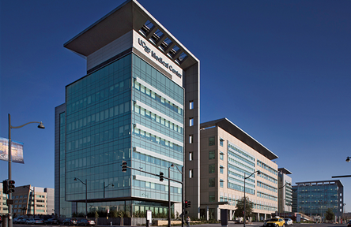
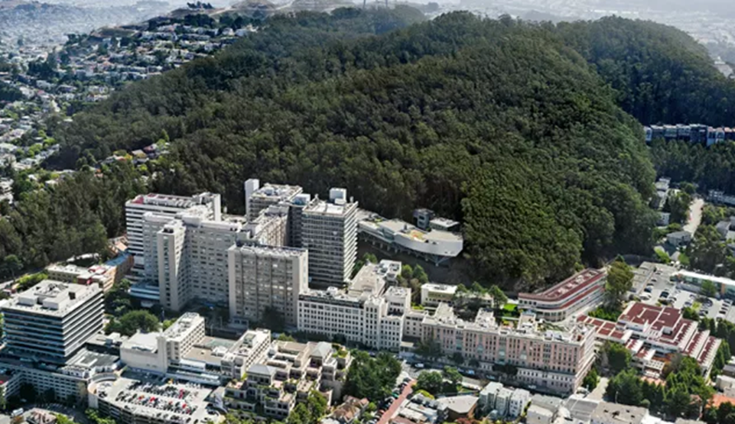
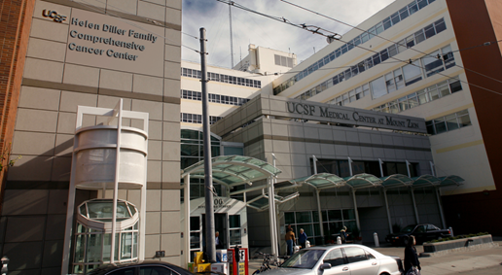
UCSF Medical Center Campuses

Slide 4
Demographics
745 beds spread in 3 campuses
Parnassus - 77 ICU beds, 107 tele/trans beds
Mount Zion - Outpatient surgical & infusion center
Mission Bay - Women and Children’s Hospital; 90 ICU beds, 16 trans beds
Research-Based & Teaching Hospital
School of Medicine, Pharmacy, Dentistry & Nursing
Over 45,000 inpatient admissions; ∼1.8 millions outpatient visits

Slide 5
Central Distribution Pharmacy
Provides pharmaceutical services to all campuses & clinics
Dispenses >90% of the total >5 million doses
>90% doses dispensed are automated
3 RIVA’s within the clean room
Non-patient specific batch preparation of ~34 CSP
215,953 doses last year, 10,490 hours, 21 doses/hr
Average 9-11 hrs/day per RIVA (max 18 hrs), 7 days per week
2.5 shifts technicians, 2.5 shifts pharmacists per day
Extended BUD based on studies

Slide 6
Why IV Automation at UCSF
Improve patient safety & reduce medication errors
Deadly meningitis outbreak at NECC (Massachusetts)
Medication errors during batching and labelling (Pts received NMBA vs Lidocaine)
UCSF on the cutting edge research & teaching of all practices
Top 10 nationwide
#1 Hospital in California

Slide 7
Why RIVA?
UCSF’s decision to use RIVA
System affixing labels
Closed System with the least human intervention
Loading w/o interfering with production
Consumables identified
Control of doses
Batching vs Pt specific doses

Slide 8
Benefits and Return on Investment of RIVA
Safety and accuracy of CSP; consistency in CSP preparation
Efficiency
Operators can perform other tasks while overseeing the robots
Reduction of staff injuries since implementation of RIVA
86% reduction in expired narcotics after implementation of RFS & Kanban inventory system
Cost savings from insourcing: ∼$800,000/year
Redeployment of pharmacists and technicians to perform more specialized and strategic work

Slide 9
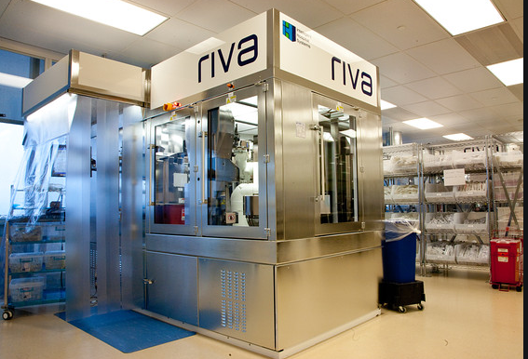
Limits and Wishlist
Labels in colors for anesthesia standard for syringes used in the OR
Syringes bagger
Mini Riva for Satellites

Slide 10
Summary
The installation of RIVA was a success at USCF Medical Center
Savings in time and money were substantial
Automation has reduced injuries & sick calls (carpel tunnel etc)
Processes and procedures needed to be modernized & updated
This was a considerable undertaking in a public hospital with numerous stakeholders to convince
New procedures ensure safety & site licenses
As a practicing Pharmacist, my confidence in the safety of doses has increased substantially – you can’t be safer than the machine!
Outsourcing these tasks frees me up for more rewarding work.

Slide 11
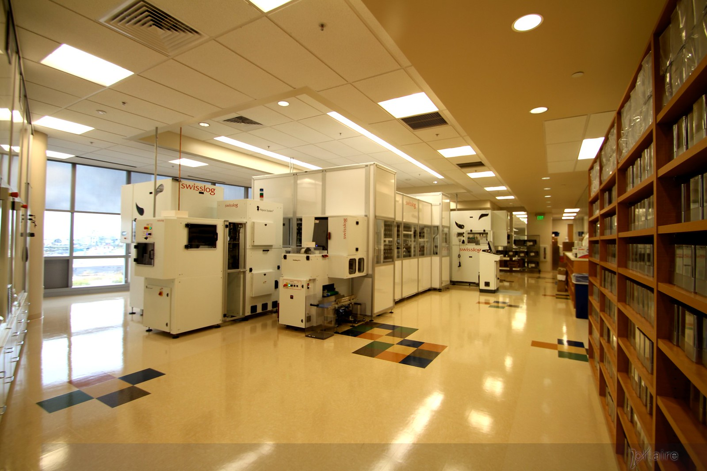
Q & A ?

